Slide 1
CCT260 Assignment 2
Macor Yuen

Slide 2
Concepts/Ideas of my webpage
I gathered and take references from celebrities official webpages.
I.E.) Michael Jackson, Bruno Mars, Taylor Swift, Twice, Marvel etc.
The logo part, I take references from Michael Jackson and Marvel webpage.
Both of them have a separate layer for their logo

Slide 3
Wireframes
Designed 6 wireframes in total.
They are Home, About Me, Photographs, Webpage Design, Wireframes (Under Webpage Design), Final Design (Under Webpage Design)

Slide 4
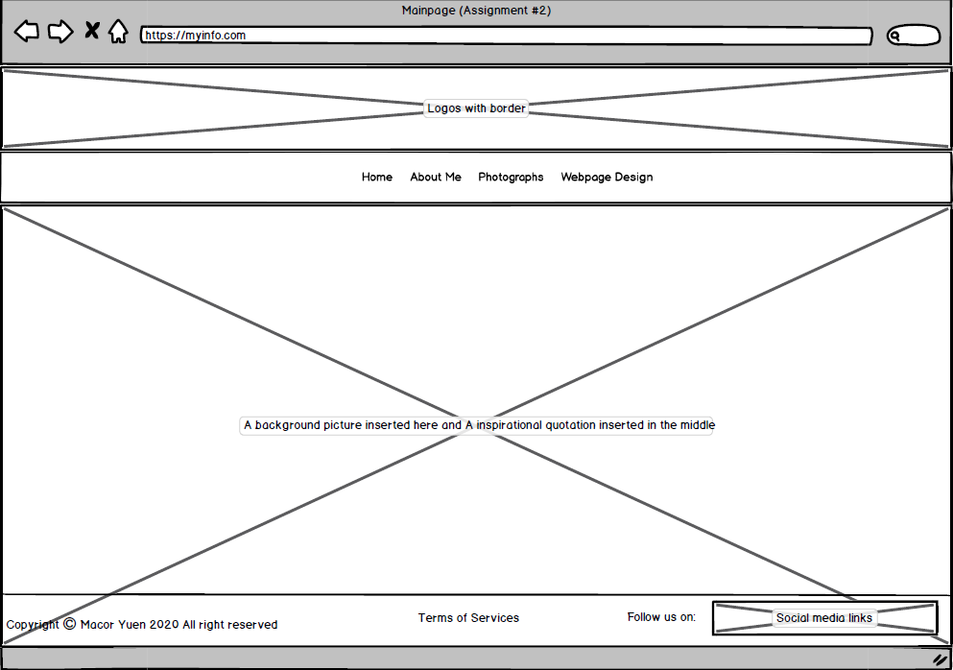
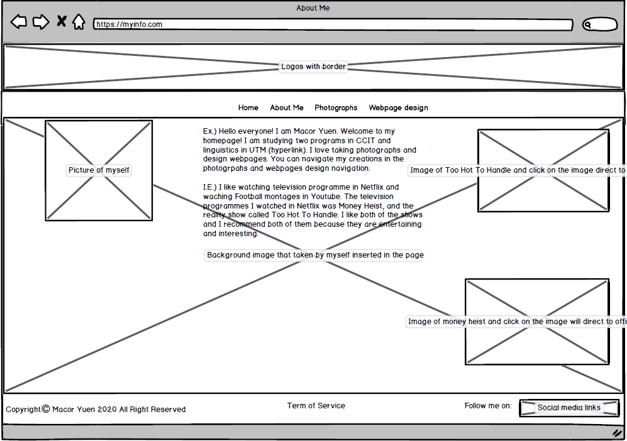
Wireframes
Home page in my webpage
About Me in my webpage

Slide 5
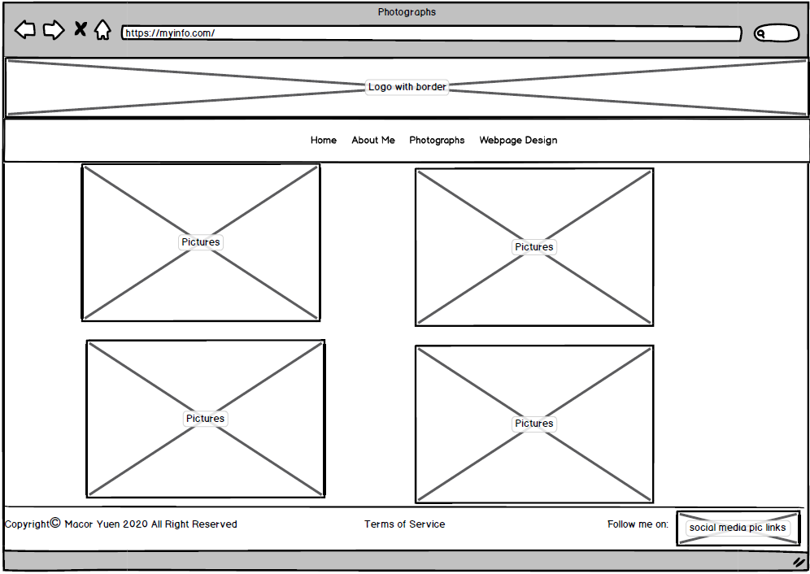
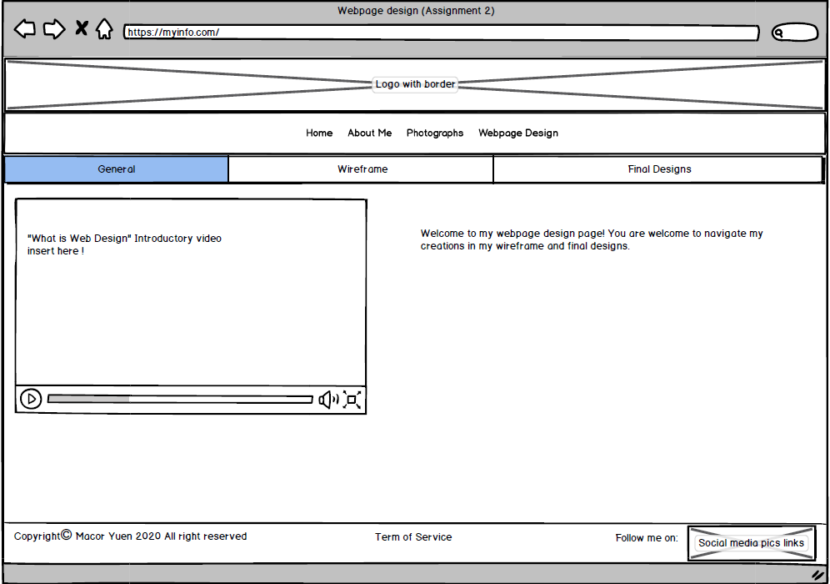
Wireframes
Photographs in my webpage
Webpage Design in my webpage

Slide 6
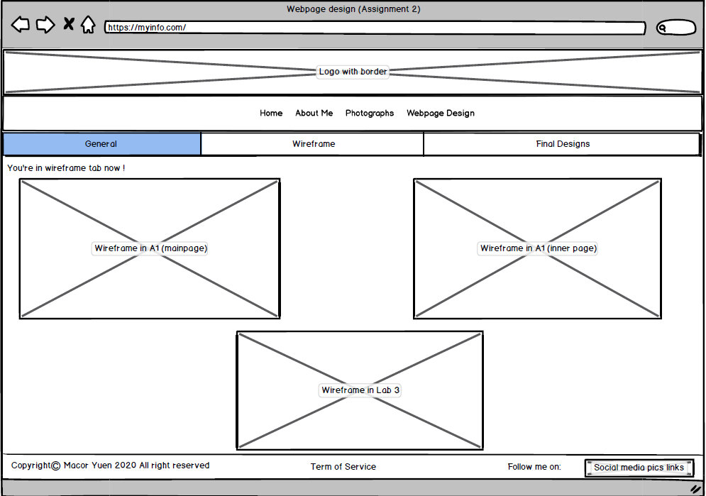
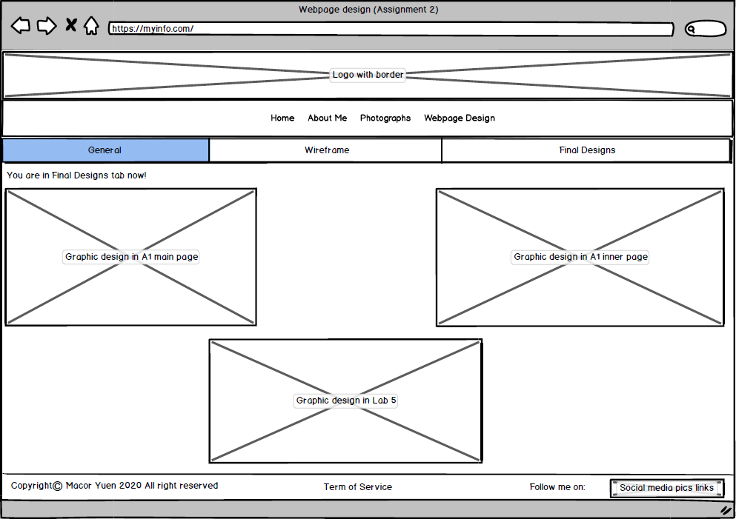
Wireframes
Wireframe (Under Webpage Design) in my webpage
Final Design (Under Webpage Design) in my webpage

Slide 7

Design elements in my webpage
In Logo Design, used Myriad Pro as font
The font size of the word is 109pt
M stands for Macor (My first name)
Y stands for Yuen (My last name)
The arrow goes up refers to keep fighting, and keep going progressively in life
Arrow goes down refers “Be Water”, be flexible
The whole arrow things mean keep going progressively with flexibility in a life cycle

Slide 8
Design elements in my webpage
Colours I used in my webpage
#554848 as background colour
#FFFFFF as foreground colour and texts
#C15D46 as users current location on global navigation
#94FFB9 notify the links that users will precede on global navigation, and anchor links and associative links
#F7B2B3 as users current location on local navigation and texts
#7E17AD as notify the links that users will precede on local navigation
#808080 as background colour of local navigation
#aedbff as background colour in Terms and Condition

Slide 9
Design elements in my webpage
Font selection
Imported two fonts from Google Fonts
Permanent Marker in Homepage and Slabo 27px in About Me
Arial are used in global navigation, and local navigation

Slide 10
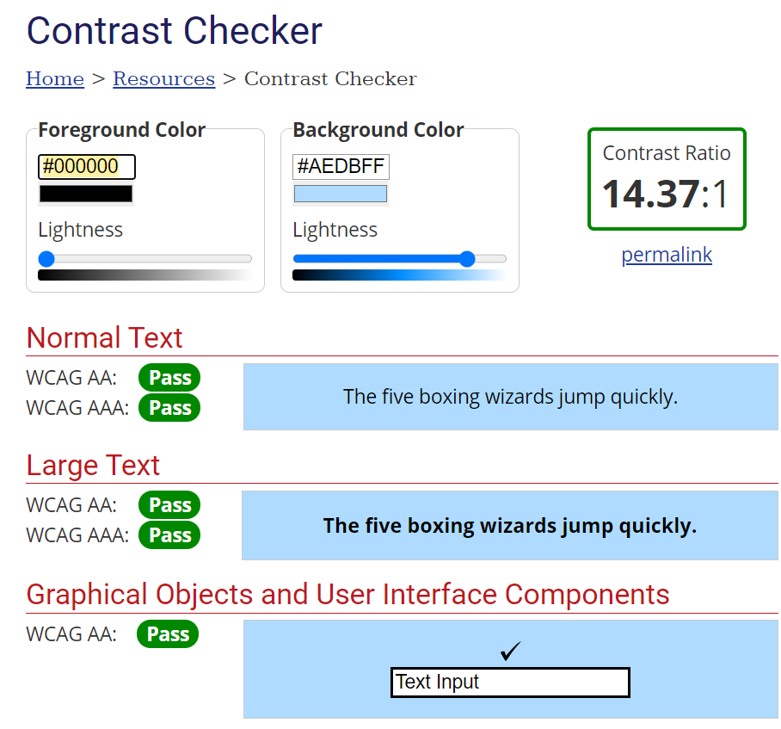
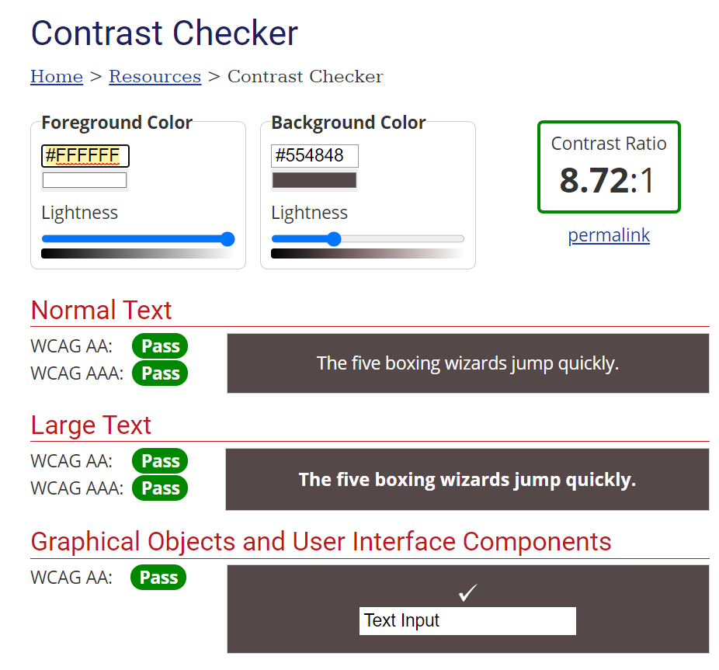
Accessibility and Usability
All the functions on the webpage could be used “tab” over
Anchor and associative links do not open a new windows to proceed
The background and foreground colour of my webpage pass the contrast test of WCAG AA and WCAG AAA

Slide 11
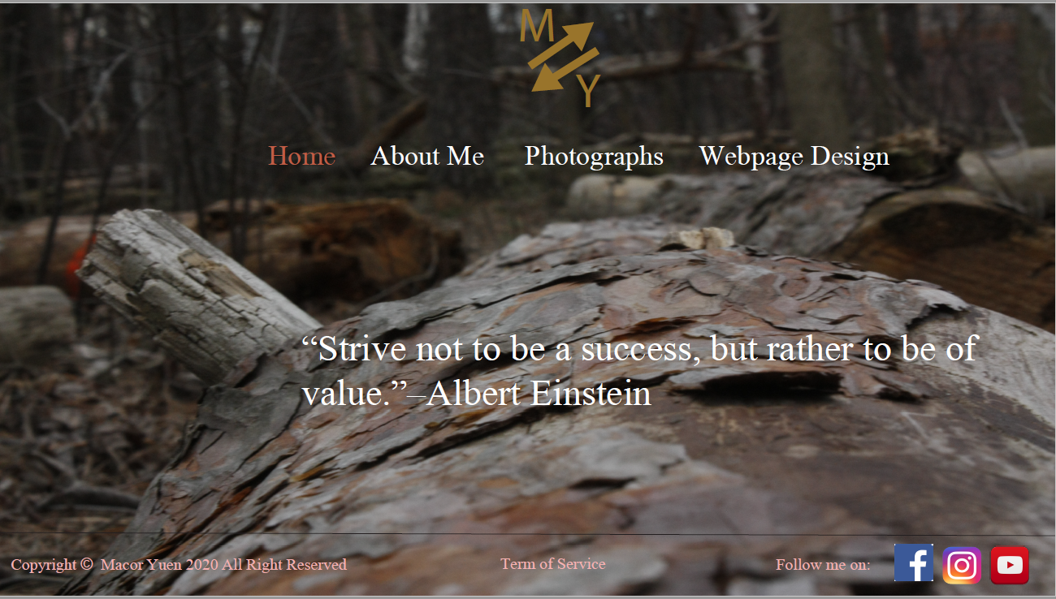
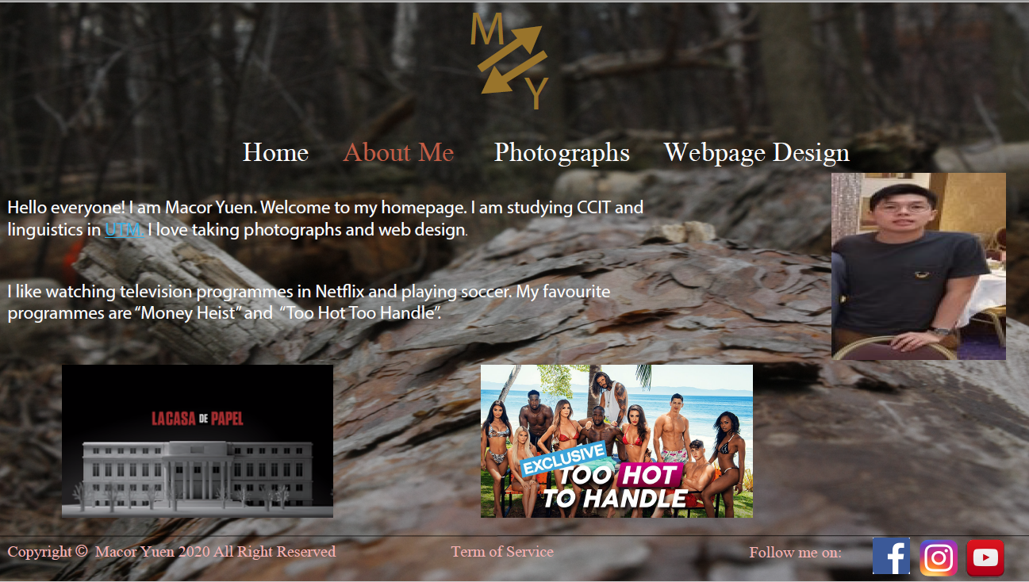
Visual & Graphics Design
Graphic Design in my Main webpage
Graphic Design in About Me webpage

Slide 12
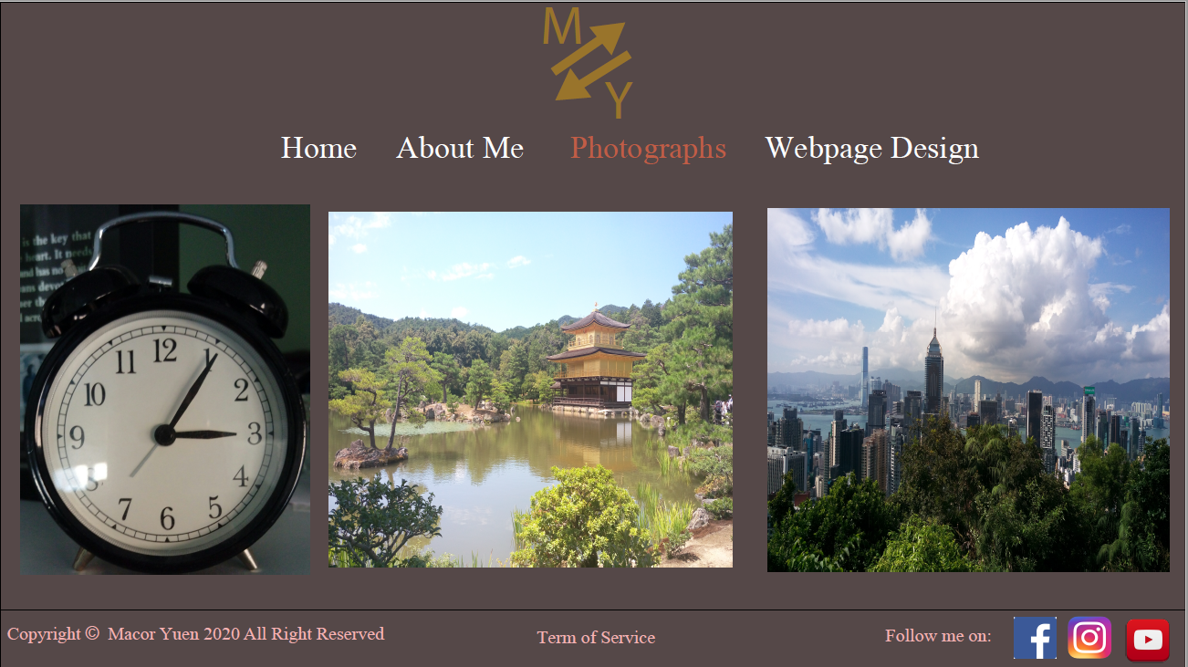
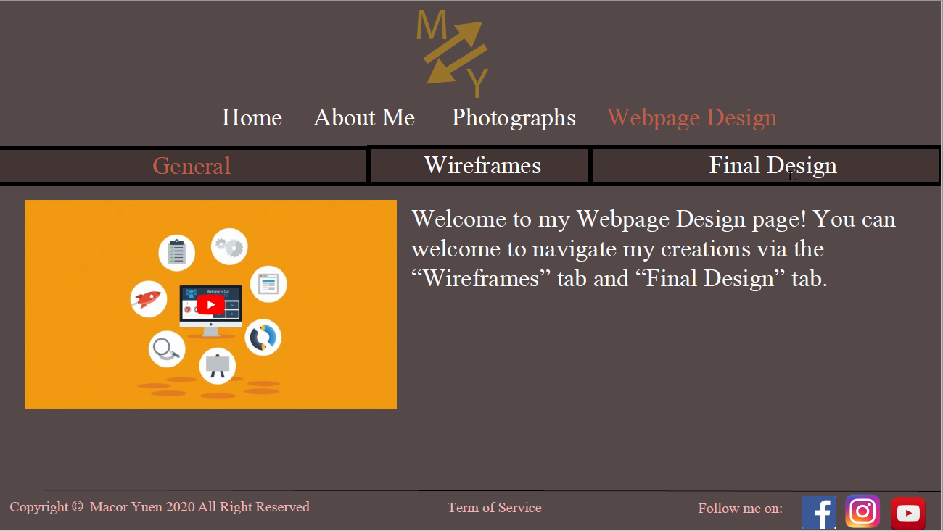
Visual & Graphics Design
Graphic Design in my Photographs webpage
Graphic Design in my Webpage Design webpage

Slide 13
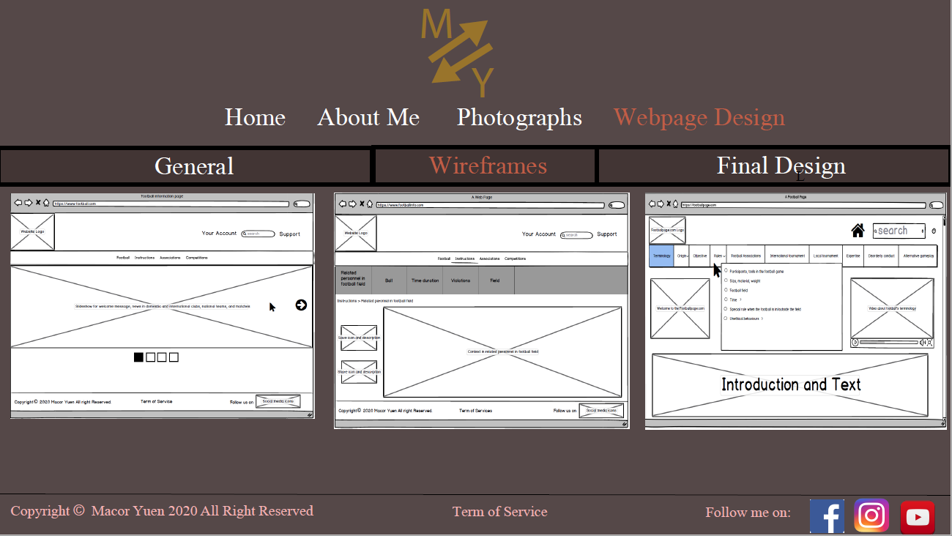
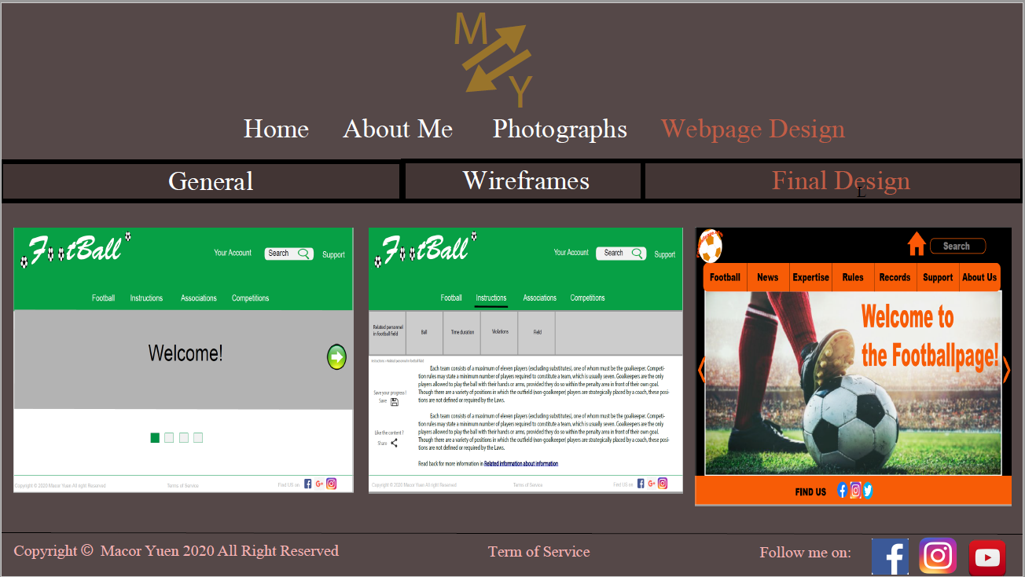
Visual & Graphics Design
Graphic Design in my Photographs webpage
my webpage

Slide 14
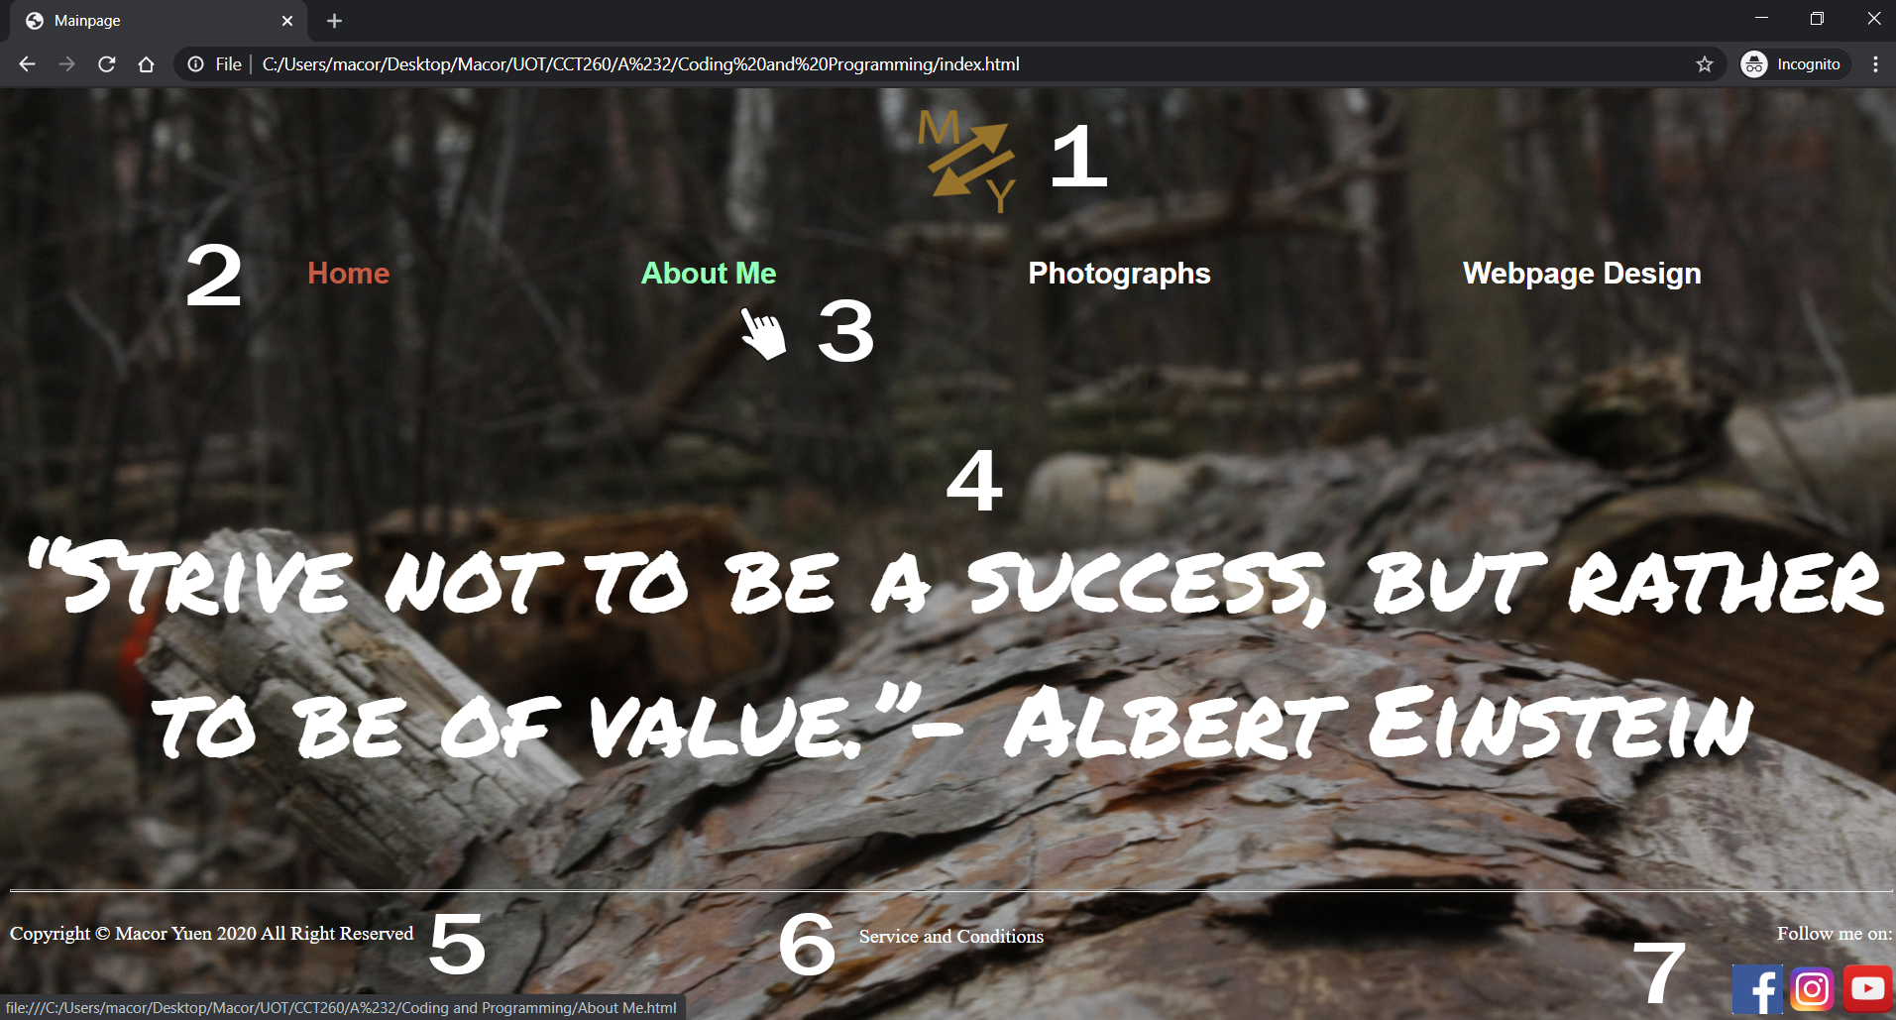
Final Visual & Graphic Design
1.) Logo on the header navigation
Users can press on the logo to return to the main page
The dimension of the logo is: width:100px x height:100px
2.) Global navigation
User can surf information through different navigation links and the brown colour show the user where is he/she is currently located.
3.) Global navigation in effect
When the cursor move closer to one of navigation links, the colour of the link change from white to green.
4.) Quotation from a prestigious person
The quotation comes from Albert Einstein, and the concept comes from the Chrome extension “Momentum”
Footer part
5.) Copyright
6.) Service and Conditions
This part is clickable while it takes users to another direct link to the terms of service
7.)Social Media links
Users can click on icons to see the creator’s status on different social media platforms on Facebook, Instagram and YouTube.

Slide 15
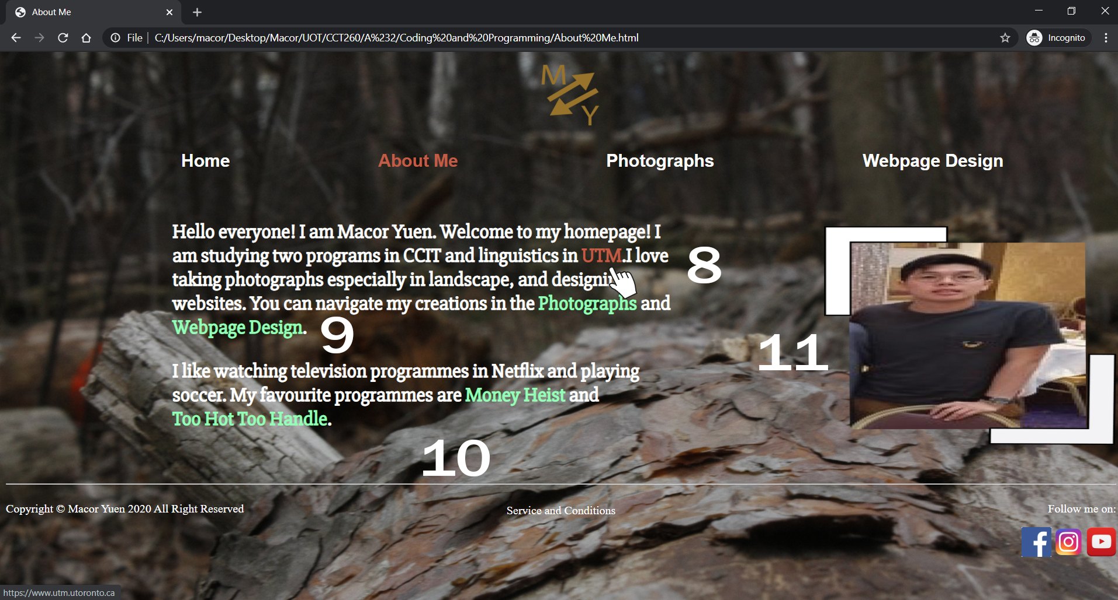
Final Visual & Graphic Design
8.) Anchor links in effect
When users click on the associative links, the colour of the text changes from green to brown. The link refer users to the official website of UTM.
9.) Associative links in first paragraph
When users click on the associative links, it will direct users to the webpage that the creator want the users to see. The links direct users to the navigation links of photographs and Webpage Design
10.) Anchor links in next paragraph
The anchor links direct users to the official website of the Television programmes “Money Heist” and “Too Hot Too Handle. Just in case, if the users are interested and want to get more information in depth
11.) Creator’s profile picture
A creator profile picture is attached in the page with the border on the right hand side of the webpage

Slide 16
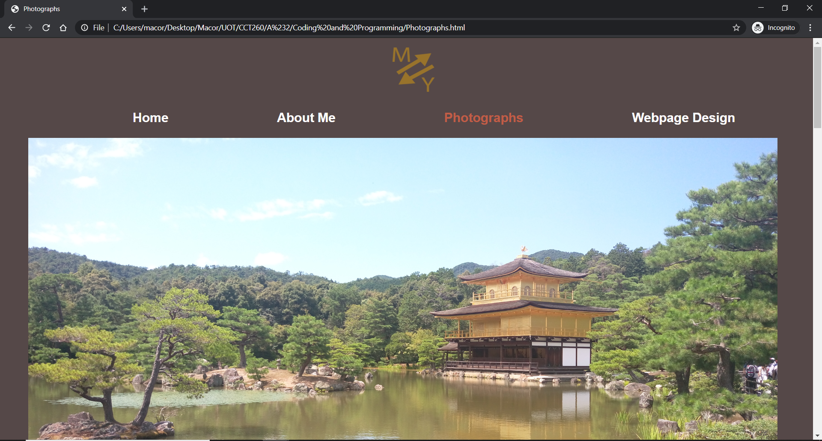
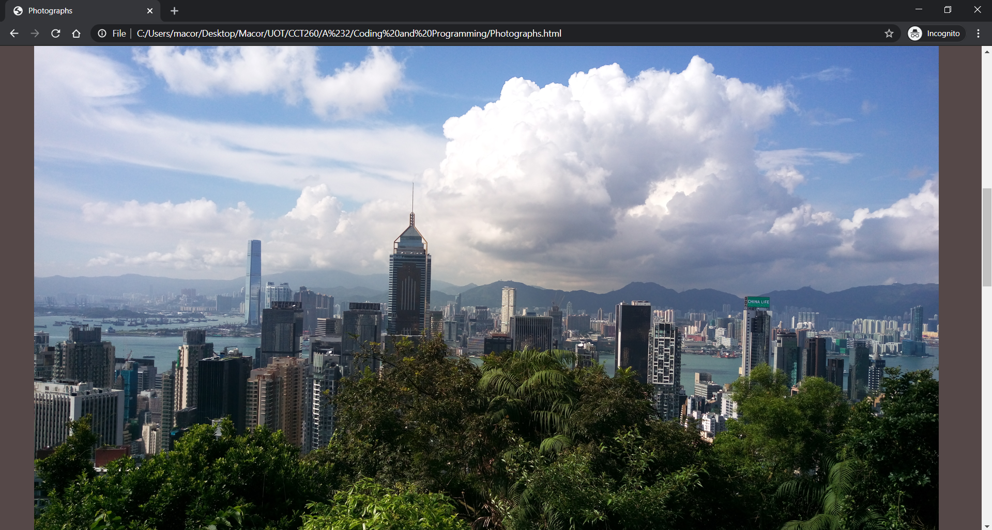
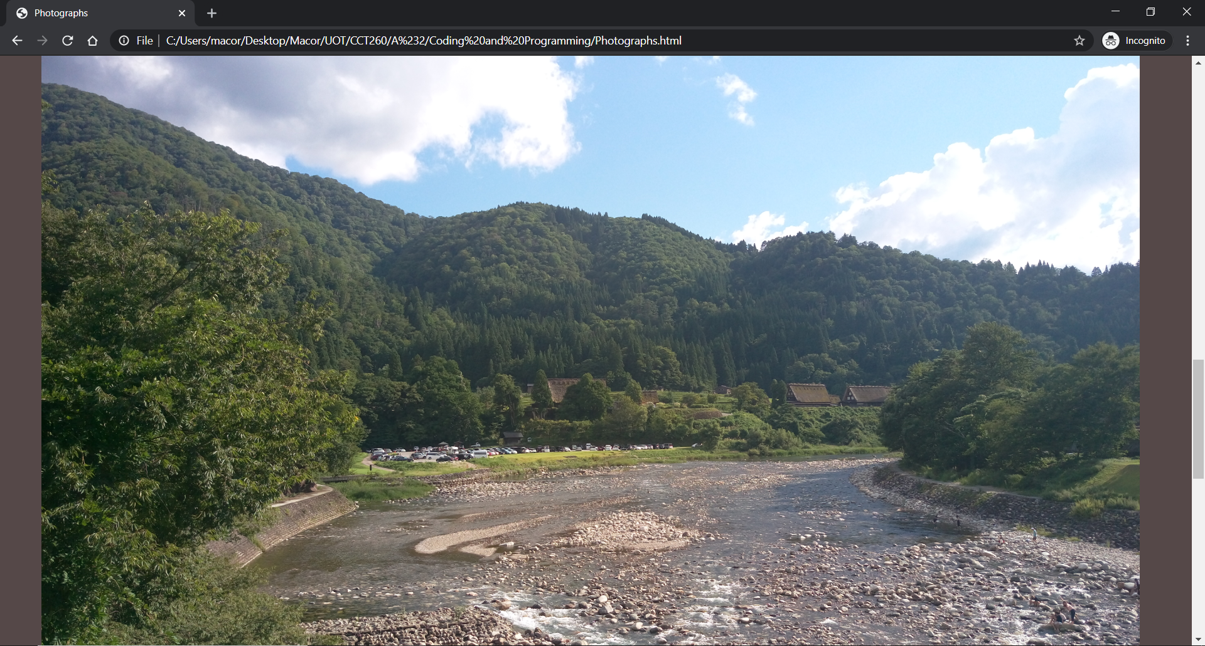
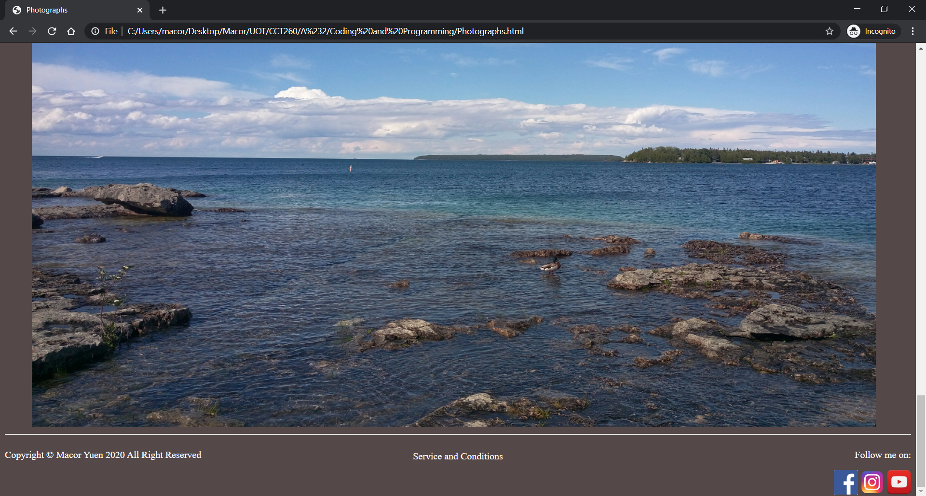
Final Visual & Graphic Design
12.) Photographs
The Photographs page attaches 4 creator’s own photo.
All images have the same dimension.
The width and height of the images are : 1400px x 800px

Slide 17
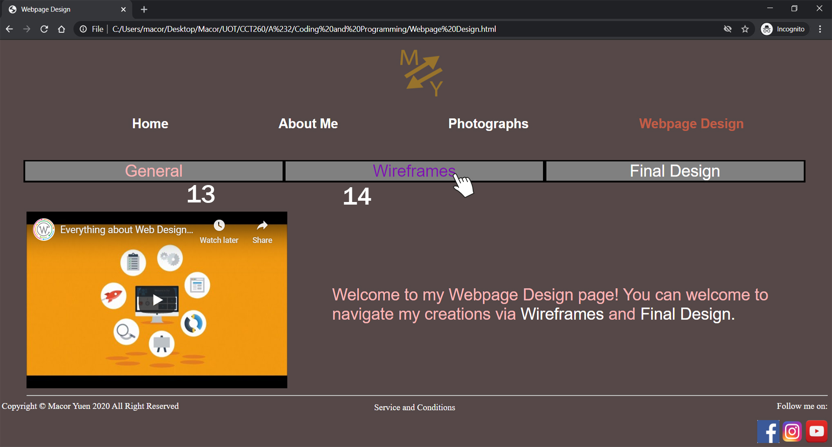
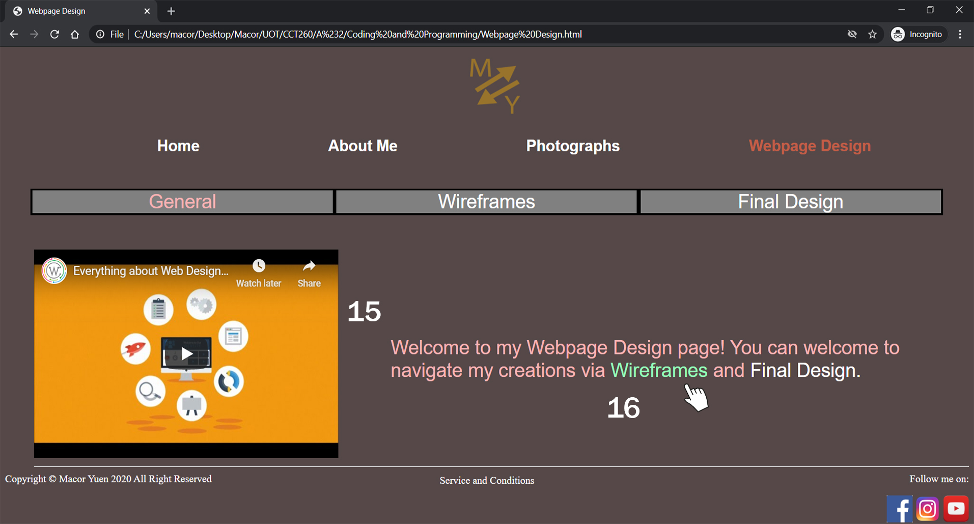
Final Visual & Graphic Design
13.) Local navigation
User can surf information through different navigation links and the pink colour show the user where is he/she is currently located
14.) Local navigation in effect
When the cursor move closer to one of navigation links, the colour of the link change from white to purple.
15.) Embedded Video
A YouTube Video is inserted in the webpage. The video describes the introductory of webpage design basics
The dimension of the video: width: 480px x height:315px
16.) Associative links in effect
When the cursor move closer to associative links, the colour of the link change from white to green.

Slide 18
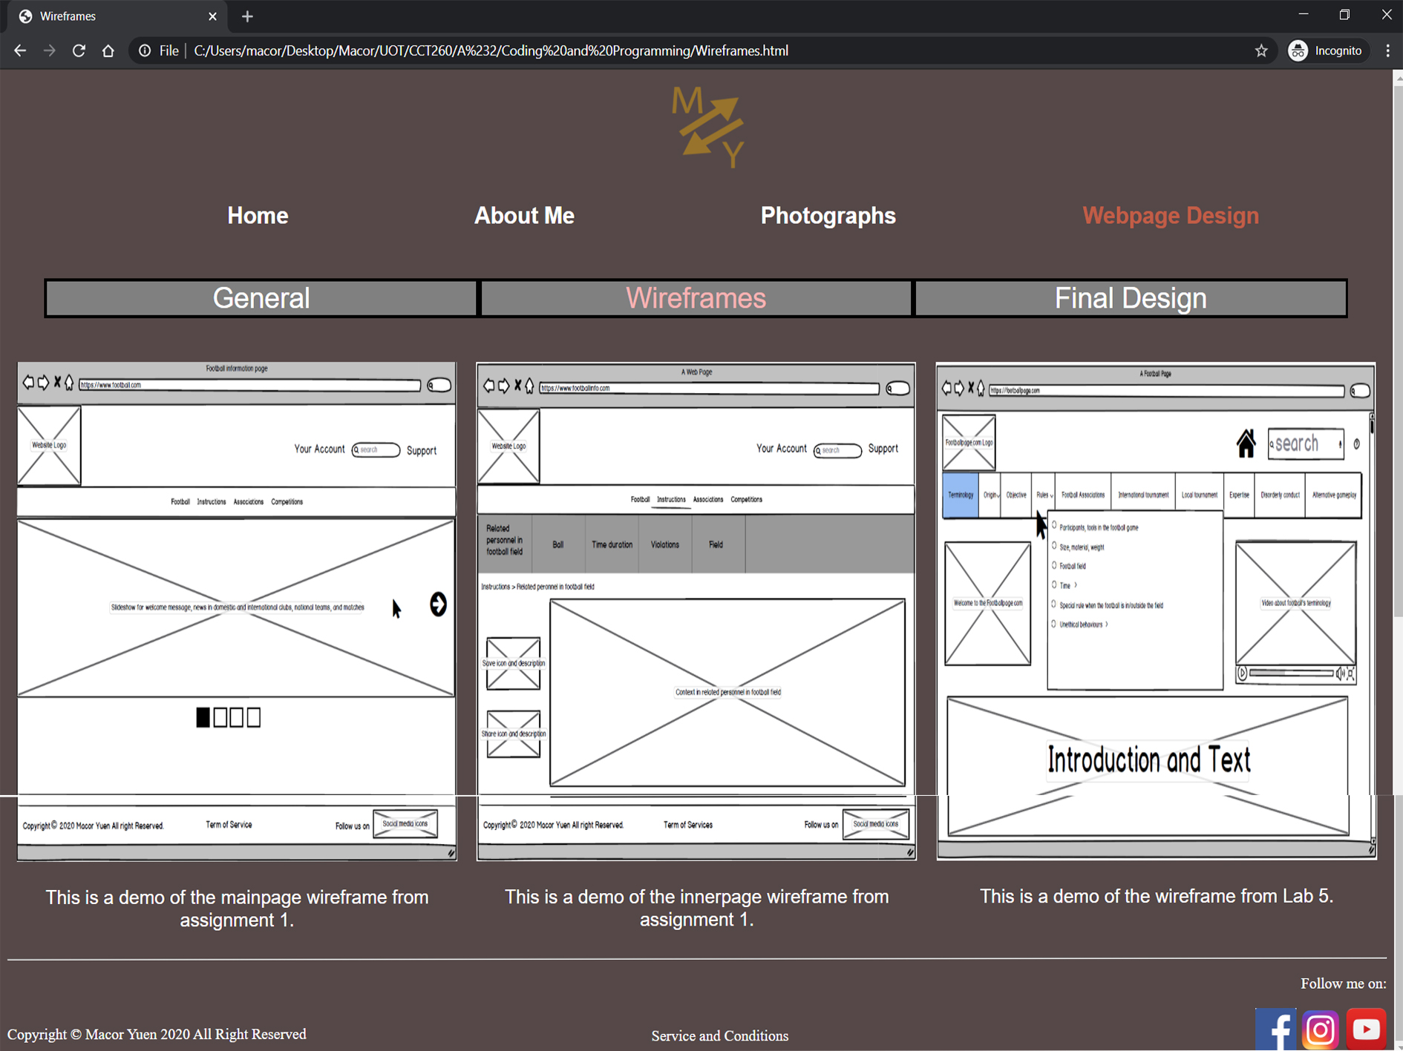
Final Visual & Graphic Design
17.) Wireframes
The Wireframes page attaches 3 creator’s own design wireframes
All images have the same dimension.
The width and height of the images are : 480px x 500px

Slide 19
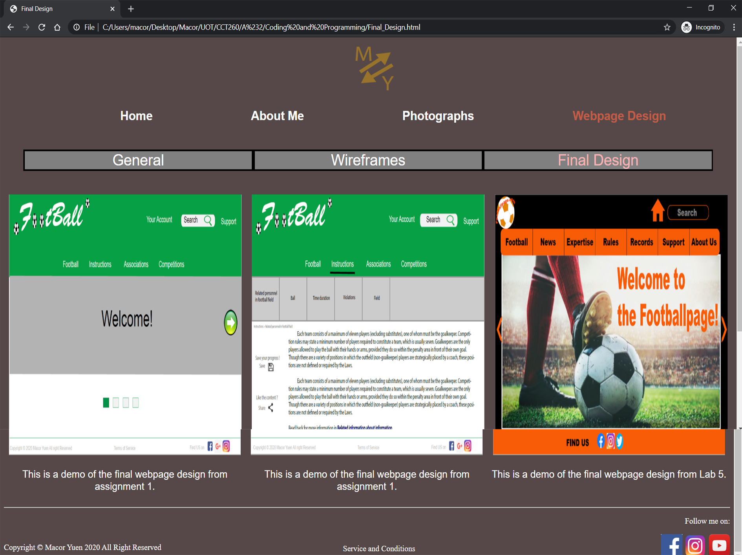
Final Visual & Graphic Design
17.) Final Design
The final design page attaches 3 creator’s own design final design on webpages
All images have the same dimension.
The width and height of the images are : 480px x 500px

Slide 20
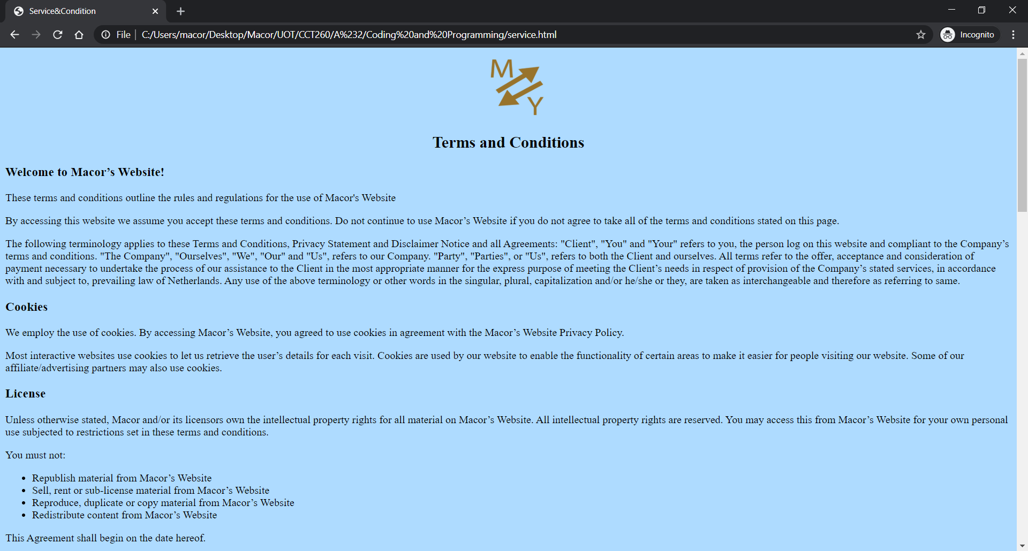
Final Visual & Graphic Design
18.) Terms and Conditions

Slide 21
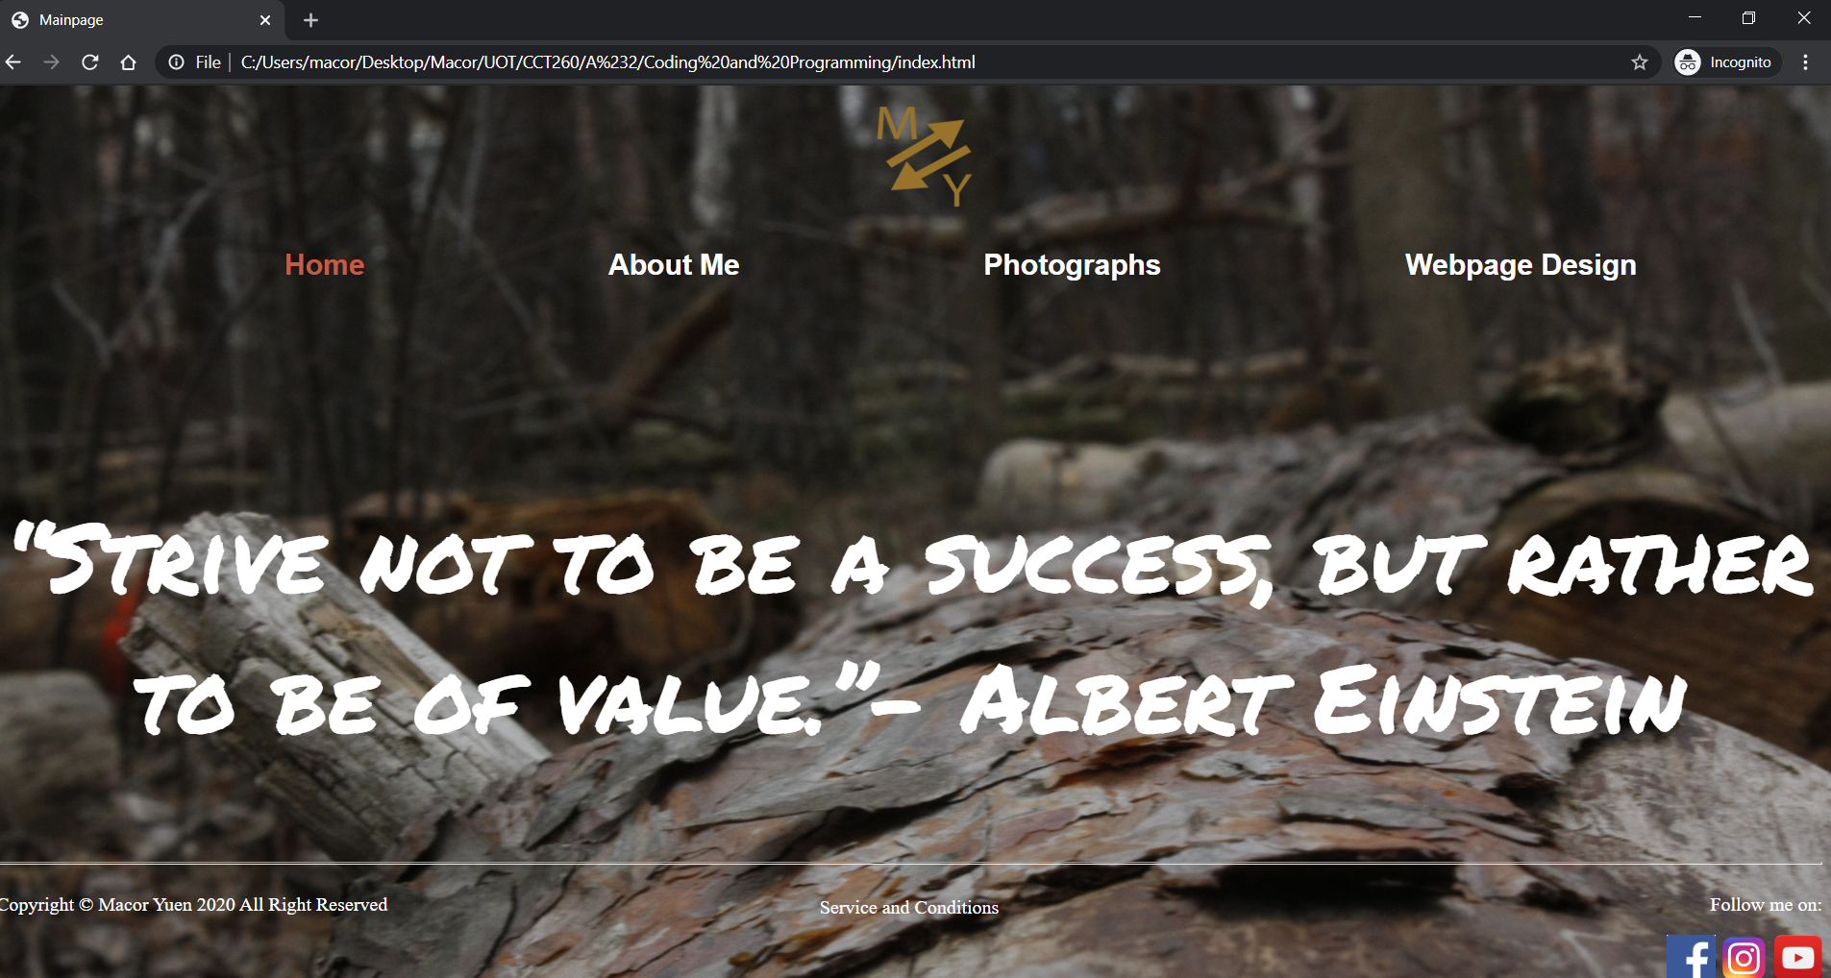
Differences between in Visual Design & Final Website
Pending Version
Final Version
1
1
3
2
2
3
1.) The font I used in quotation changes because using regular font looks normal as on the left
Using special font on the right makes more attractive
2.) The colour of font changes from pink to white in footer navigation
Using white colour makes users easier to notice
3.) The social media icons cannot place in the same line with copyright and term of service
Therefore, the icons have to place under the line of “Follow me on”

Slide 22
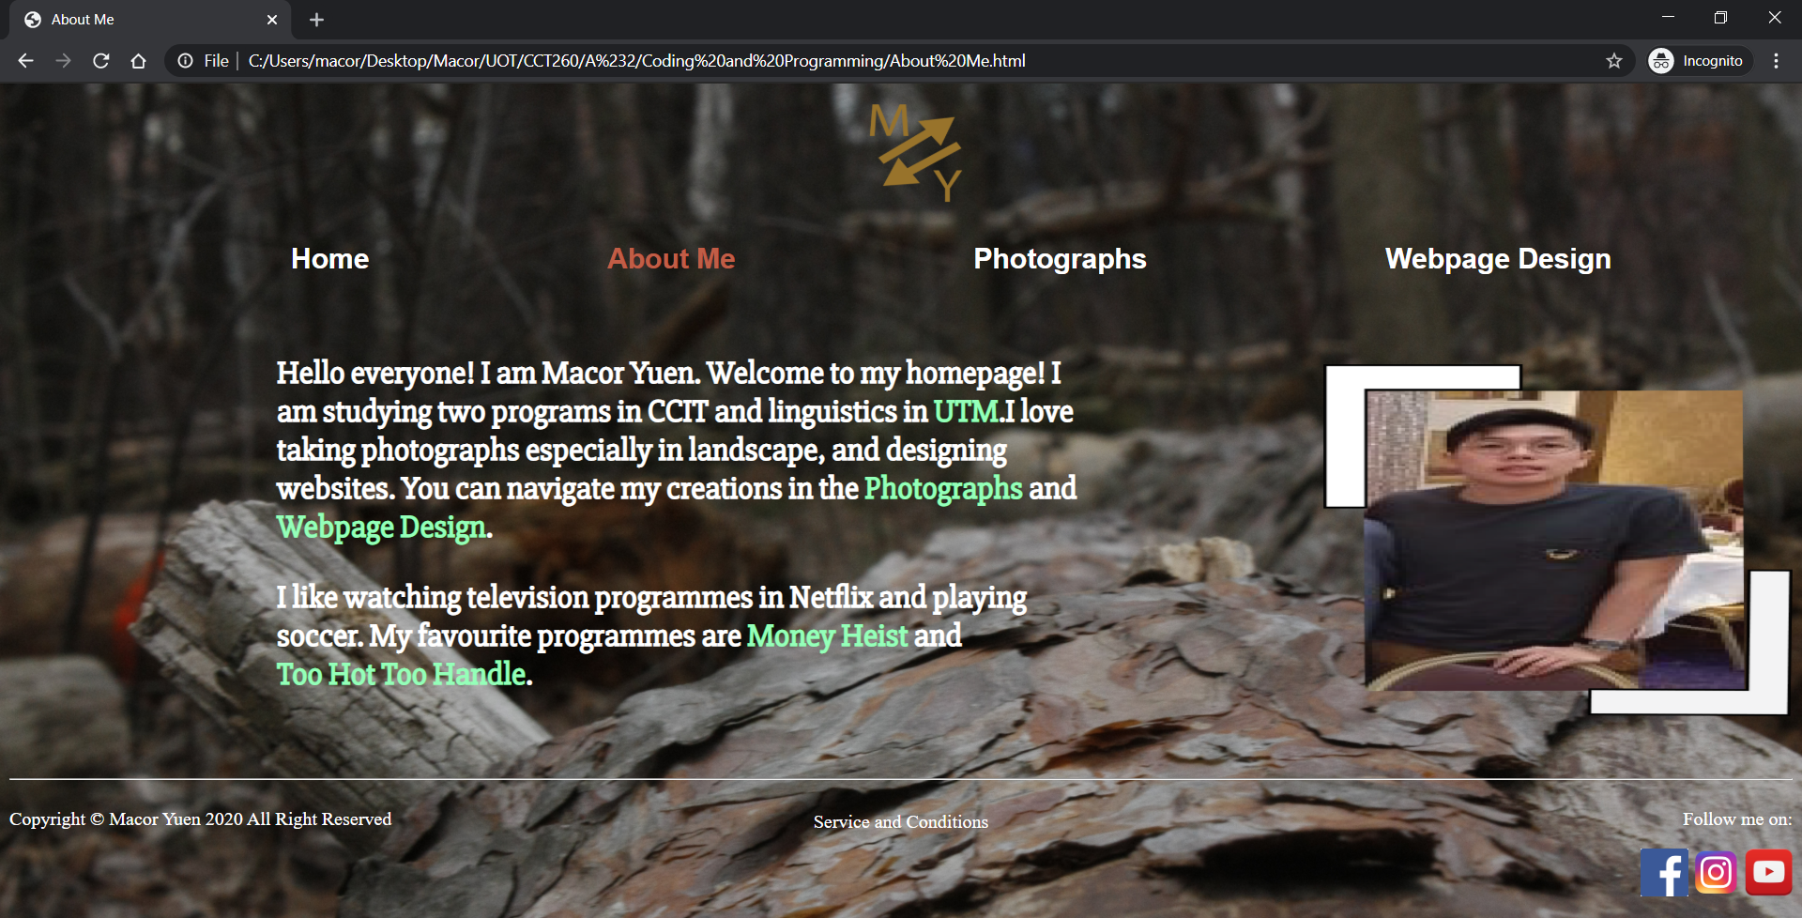
Differences between in Visual Design & Final Website
Pending Version
Final Version
2
2
1
1
3
3
1
1
4
4
3
2
2
3
1.) A border added to my profile picture
It looks kind of unorganised without border
2.) The colour of any anchor and associative links change from blue with underline to green
Users know the links are clickable
3.) Photographs and Webpage Design become a link are clickable
Users can navigate directly to view creator’s contents
4.) Photographs are deleted, and replaced by anchor links
Images are originally clickable and direct users to the official website of the programmes
Due to the appearance of webpage look kind of messy if images still exist

Slide 23
Differences between in Visual Design & Final Website
Pending Version
Final Version
1.) Dimension of the images change
Width: 333.312 px x 425.6298px (alarm clock image)
Width: 465 px x 409px (pavilion image in the left)
Width: 463.3333px x 418px (skyscraper image in the left)
Width: 1400 px x 800px (all images in the right)
Despite I want users see the full size of the images

Slide 24
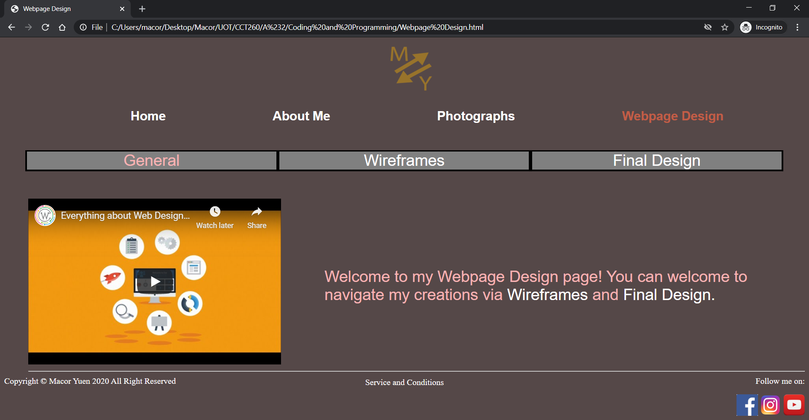
Differences between in Visual Design & Final Website
Pending Version
Final Version
1
1
2
2
1
2
1
3
3
1
1
4
4
2
3
2
2
3
1.) Colours of local navigation change
Background colour of local navigation change from transparent to grey
Brown colour change to Pink for users to see where users current location
2.) Colour of anchor links and texts
The text colour from white changes to pink
The colour of anchor links remain white

Slide 25
References
2020. [online] Available at: <https://www.youtube.com/watch?v=F4fbwKV9dBU> [Accessed 14 June 2020].
2020. [online] Available at: <https://twice.jype.com/video.asp> [Accessed 14 June 2020].
2020. [online] Available at: <https://www.youtube.com/watch?v=Q0FIkz_kvk4> [Accessed 14 June 2020].
Bruno Mars Official Website. 2020. Bruno Mars 24K Magic World Tour I 24K Magic Available Now. [online] Available at: <https://www.brunomars.com/?frontpage=true> [Accessed 14 June 2020].
Clipart-library.com. 2020. Free Youtube Logo Png Transparent, Download Free Clip Art, Free Clip Art On Clipart Library. [online] Available at: <http://clipart-library.com/free/youtube-logo-png-transparent.html> [Accessed 14 June 2020].
En.wikipedia.org. 2020. Money Heist. [online] Available at: <https://en.wikipedia.org/wiki/Money_Heist> [Accessed 14 June 2020].
Kruse, K., 2020. Top 100 Inspirational Quotes. [online] Forbes. Available at: <https://www.forbes.com/sites/kevinkruse/2013/05/28/inspirational-quotes/#fa9d09c6c7ac> [Accessed 14 June 2020].
Marvel Entertainment. 2020. Watch Marvel Digital Series, Trailers, & Videos | Marvel. [online] Available at: <https://www.marvel.com/watch> [Accessed 14 June 2020].
Michael Jackson Official Site. 2020. Home | Michael Jackson Official Site. [online] Available at: <https://www.michaeljackson.com/> [Accessed 14 June 2020].
Stickpng.com. 2020. Facebook Icon Transparent PNG - Stickpng. [online] Available at: <https://www.stickpng.com/img/icons-logos-emojis/tech-companies/facebook-icon> [Accessed 14 June 2020].
Stickpng.com. 2020. Instagram Logo Transparent PNG - Stickpng. [online] Available at: <https://www.stickpng.com/img/icons-logos-emojis/tech-companies/instagram-logo> [Accessed 14 June 2020].
Taylor Swift. 2020. Taylor Swift. [online] Available at: <https://www.taylorswift.com/> [Accessed 14 June 2020].
Privacypolicyonline.com. 2020. Terms & Conditions Generator - Privacy Policy Online. [online] Available at: <https://www.privacypolicyonline.com/terms-conditions-generator/> [Accessed 14 June 2020].
Webaim.org. 2020. Webaim: Contrast Checker. [online] Available at: <https://webaim.org/resources/contrastchecker/> [Accessed 14 June 2020].
Vexels.com. 2020. Hand Cursor. [online] Available at: <https://www.vexels.com/png-svg/preview/130804/hand-cursor-pointer> [Accessed 14 June 2020].

